Slide 1
PREDICTIVE GRADING OF CHILDHOOD AUTISM
Guided By Group 4
Dr.REJI R MADHAV S NAIR
Associate Professor APARNA PRATHAP
Dept of CSE AJEENA ASHARAF
CCET

Slide 2
INTRODUCTION
Autism Spectrum Disorder (ASD) is a clinically heterogeneous neurological developmental disorder.
Early diagnosis and proper intervention is required for the effective treatment of autism.
The expertise of the clinician is so important in the proper diagnosis and classification of autism.
This project proposes an Expert system that act as a support system to the clinician.

Slide 3
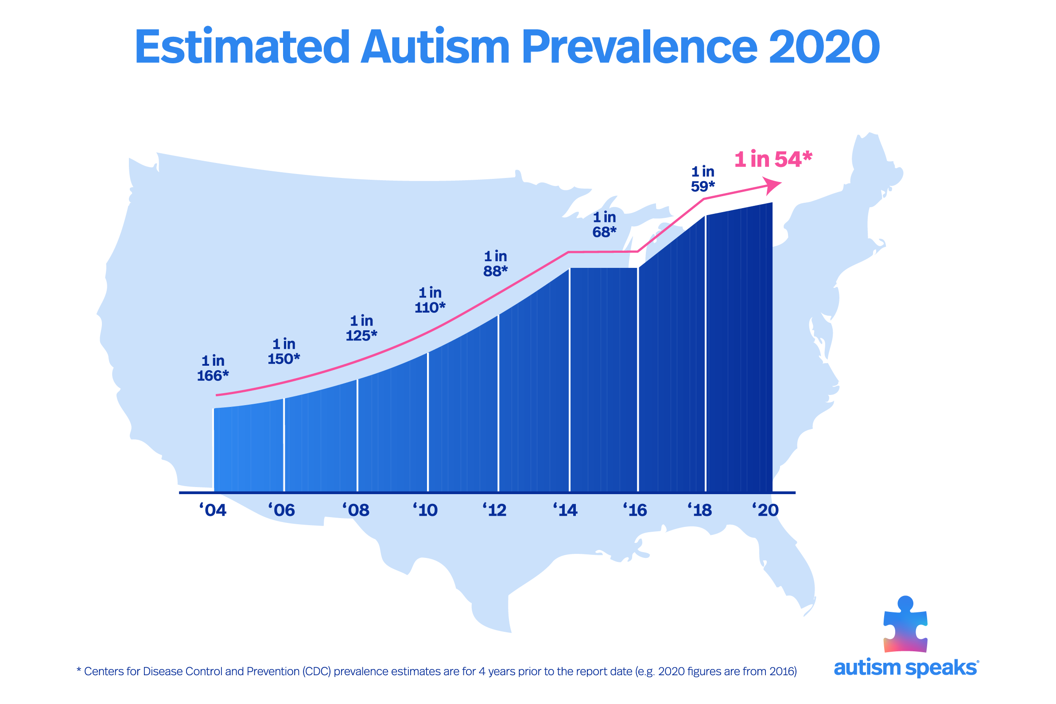

Slide 4
LITERATURE SURVEY
MANAGEMENT OF CHILDREN WITH ASD
By minimising the core autism spectrum disorder features, facilitating development and learning, promoting socialisation, reducing maladaptive behaviours, and educating and supporting families, the treatment's primary goals are to maximise the child's ultimate functional independence and quality of life.
Methodologies used are:
Speech and Language Therapy
Applied behaviour analysis.
Social skill instructions.
Advantage : Improve the quality of life.
Disadvantage : Management of associated medical problems

Slide 5
2. 3D HUMAN FACE DESCRIPTION:LANDMARK MEASURES AND GEOMETRICAL FEATURES
Descript faces by Morphometric measures and geometrical features.
Methodologies used are:
Euclidean distance
Geodesic distance
Advantage :Effective and suitable to a face description.
Disadvantage :Geodesic distance were not more effective than Euclidean distances between the same landmarks

Slide 6
3. Facial phenotypes in subgroups of prepubertal boys with autism spectrum disorders are correlated with clinical phenotypes.
In this study, tested two hypotheses. First, they asked whether children with ASD display a subtle but distinct facial phenotype compared to typically developing children. Secondly, they sought to determine whether there are subgroups of facial phenotypes within the population of children with ASD that denote biologically discrete subgroups.
Methodologies are:
Three-dimensional stereophotogrammetric imaging
Anthropometric landmark data collection
Behavioral and medical data
Potential differences in etiologies for the various subgroups of children.

Slide 7
4. Facial Structure Analysis Separates Autism Spectrum Disorders into Meaningful Clinical Subgroups
Varied cluster analysis were applied to facial surface measurements from 62 prepubertal boys with essential autism to determine whether facial morphology constitutes viable biomarker for delineation of discrete Autism Spectrum Disorders (ASD) subgroups.
Methodologies are:
Comprehensive cluster analysis techniques
Facial surface measurements
This may help predict disorder severity and regression and has translational relevance as this ASD
subset may represent genetically distinct individuals for whom specific treatment options may be tailored.

Slide 8
5. Anthroprometric 3D Face Recognition
Novel anthropometric three dimensional (Anthroface 3D) face recognition algorithm, which is based on a systematically selected set of discriminatory structural characteristics of the human face derived from the existing scientific literature on facial anthropometry
Methodologies are
Novel technique
Face recognition algorithm
Isolate and employ unique textural and/or structural characteristics of these fiducial points, along with the established anthropometric facial proportions of the human face for detecting them.

Slide 9
6.Three-Dimensional Face Recognition
They can be demonstrate a prototype system based on the proposed algorithm and compare its performance to classical face recognition methods.
Methodologies are:
Face recognition algorithm
It allows us to perform the 3D face recognition task while avoiding the surface reconstruction stage.

Slide 10
7.Research on autism spectrum disorders in India
Autism spectrum disorders (ASD) are a complex group of neurodevelopmental disorders characterized by triad of impairments in communication skills, social skills and repetitive behaviour.
Methodologies are:
Rating scales
Genetics
Neurobiology
Advantage : Graphic rating scales are less time consuming to develop
Disadvantage :Enhancing Neurological Functions: Could have long term damage on developing brains.

Slide 11
8.Advanced Parental Age and the Risk of Autism Spectrum Disorder
This study evaluated independent effects of maternal and paternal age on risk of autism spectrum disorder.
Methodologies are:
Analytic strategy
statistical methods
Parental ages modeled as continuous variables
Multivariable analysis of parental ages modeled as categorical variables

Slide 12
9.Biomarkers in autism spectrum disorder: the old and the new
Rationale Autism spectrum disorder (ASD) is a complex heterogeneous neurodevelopmental disorder with onset during early childhood and typically a life-long course.
Methodologies are:
Neuropsychological biomarkers/endophenotypes
Biomarker research has great heuristic potential in targeting autism diagnosis and treatment

Slide 13
10.Face Recognition Deficits in Autism Spectrum Disorders Are Both Domain Specific and Process Specific.
We show that children with ASD are impaired in face memory, but not face perception, demonstrating process specificity.
Methodologies are:
Autism Diagnostic Observation Schedule (ADOS)
Provide a more precise characterization of the cognitive phenotype of autism and further indicate a functional dissociation between face memory and face perception.

Slide 14
Existing system
3D Facial Features in Neuro Fuzzy Model for Predictive Grading Of Childhood Autism
It proposes an Expert system that act as a support system to the clinician. Major clinical attributes of autism along with facial features are used as input to the expert system.
The main highlight is the use of features from 3D facial imagery for autism classification
Aim is to extract the exact geometrical information from the face under scrutiny and compare it with a template and used this information for training.

Slide 15
Proposed System
This project proposes an Expert system that act as a support system to the clinician.
Divided into 3 category
1)QUESTIONNAIRE (70%)
2)FACIAL ATTRIBUTES (20%)
3)PARENTAL STATUS (10%)

Slide 16
Facial recognition based on the Facial Features.
a) Open Eyes.
b) Wide Mouth.
c) Large region between mouth and nose.
d) Expression less face.
e) Open mouthed Appearance.
f) Prominent Forehead.

Slide 17
Divided into Three Modules
Module -1
Questionnaire in parents
Module-2
Facial recognition in autistic child
Module-3
Facial recognition in parents

Slide 18
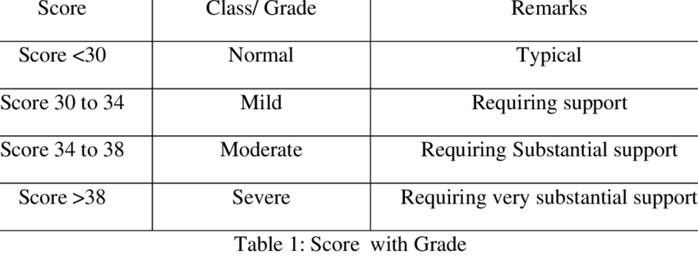
Classifying the score obtained as shown below

Slide 19
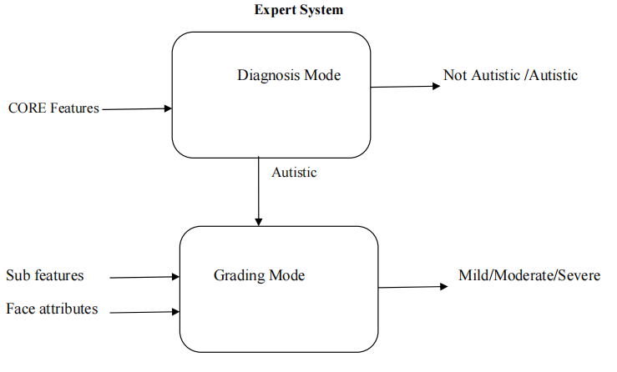

Slide 20
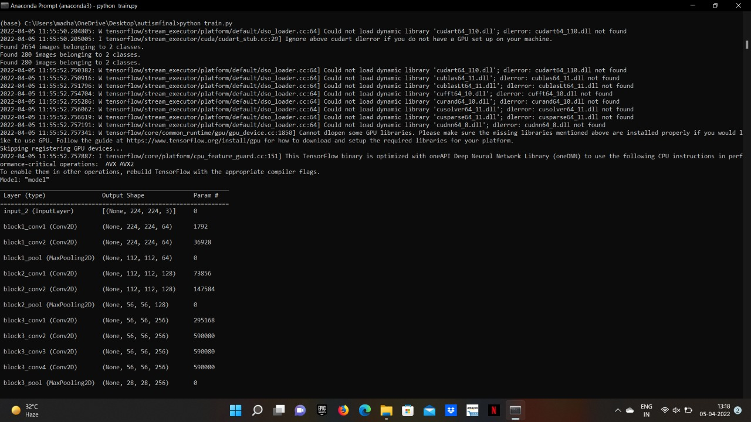
Current Status

Slide 21
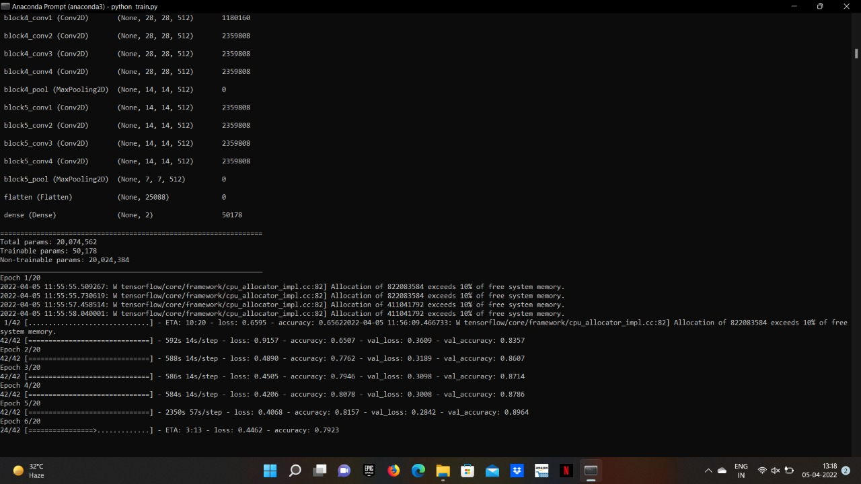

Slide 22
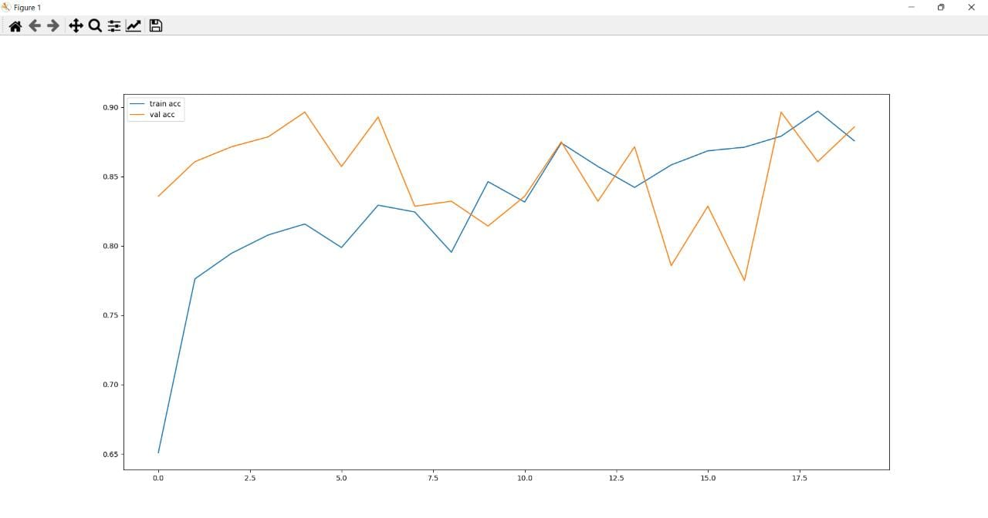
Accuracy for Training

Slide 23
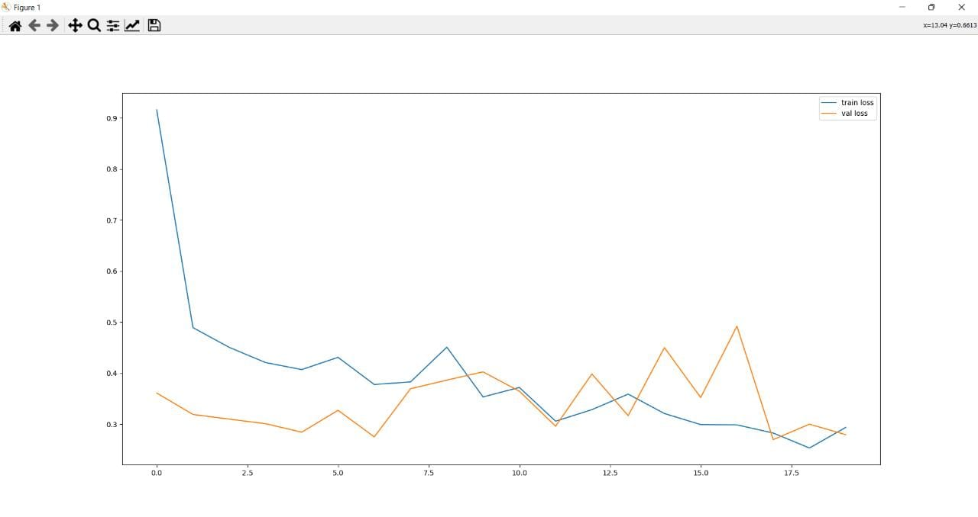
Loss for Training

Slide 24
Libraries are given below
Numpy
Learn to create data in form of datasets and analysing data using python
2. Pandas
To create data frames and analyse them and to visualise data in form of 3D graphs and 2D grahs
3. TensorFlow
It is foundation library that can be used to create Deep Learning models directly or by using wrapper libraries that simplify the process built on top of TensorFlow
4. Glob
It is used to return all file paths that match a specific pattern
5. Flask
Creating web applications in Python easier
6. Cv2
Unofficial pre-built CPU only OpenCV packages for Python

Slide 25
THANK YOU

